Slide 1
Town Centre Management Evidence from Italy and Sweden
Federica Caboni
Department of Economic and Business Science
University of Cagliari, Italy

Slide 2
Italian Context
In 1998 the Government passed a national law called the “Bersani Decree” to enable Italy to respond to:
Modernise the economy by encouraging several kinds of retailing
Regulate the growth of artificial shopping centres outside the Town Centre
Support traditional retailers within the Town Centre

Slide 3
The “Bersani Decree”
Increase competition in the Italian retail sector through:
Abolition of a set of regulations
Protection of existing network of smaller town centre retailers
Liberalization of shop opening hours
Introduction of a classification of retail activities
Cancellation the limit on the number of stores per City

Slide 4
After Bersani Decree
Several Italian Regions issued Regional Laws on “Centri Commerciali Naturali” (CCN)¹
In order to preserve the traditional retail within Town Centre
¹ Natural Shopping Centre

Slide 5
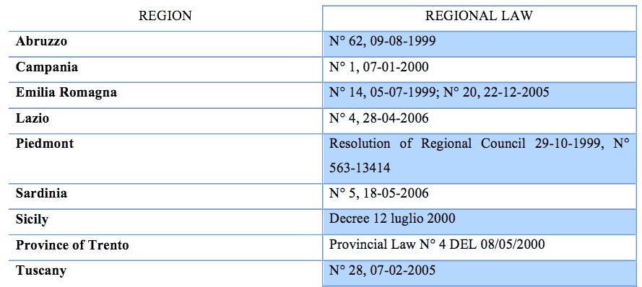
Italian CCN’s Regional laws

Slide 6
Natural Shopping Centres
“Formal partnership of local independent businesses that work together on coordinated and proactive initiatives, to enhance the value of the Town Centre”

Slide 7
Why was the Natural Shopping Centre created?
To revitalize the Town Centre and its retail activities
To regenerate traditional shopping areas and attract people

Slide 8
Italian Strategies
Nowadays not every Region has a guide that certifies the number of CCN’s per Region
Therefore the main representative associations of Trade companies and the Chamber of commerce work together in order to improve the number of CCN’s
Supported by Regional Funding and European Regional Development Fund (ERDF)
Notes:
3 for Objective 2 Regions in which most Italian Regions were identified

Slide 9
Italian Experience
Retailer-led approach
Public-led approach

Slide 10
Retailer-led Approach
Is created by initiative of the traders category organizations
There is a voluntary annual contribution to become a member and / or contributions for ad hoc projects
The main activities are related to promotional activities, loyalty, customer services
The public sector contributes with a partial financial contribution, but not entering in the initiative
Often there is a coordination with cultural and tourist organizations

Slide 11
“CesenaInCentro”
The “CesenaInCentro” TCM scheme was created in 2003
Aims to revitalize the Cesena’s town centre with a strategic actions by involving cultural, entertainment, tourist and public institutions
The promotion of retail activities is one of the main drivers directed to reclaim the importance of the town centre’s retail and tourist businesses

Slide 12
Main Activities
To overcome the parking problems
Free shuttle available all night with bus stops located opposite Cesena’s main evening attractions
Events organised in cooperation with cultural institutions and associations
Cultural, social and musical events are increased through free tickets for customers of retailers of the TCM
Child entertainment; prize competitions for customers; customers services for home delivery’s purchases
Notes:
1 was created a campaign retailers offering free parking tickets to their customers in underground parks situated just outside the pedestrian zone.
2 such as cafes, restaurants, theatres, discos.
3 Free tickets for museums and exhibitions are offered by TCM scheme’s member

Slide 13
Public-led Approach
Developed through a Regional law
Municipalities get funding for projects aimed at urban revitalization
Funding have a limited time horizon and intended solely to specific proposals approved
The local authority achieves only structural interventions

Slide 14
“Piedmont Project”
In this region were created through specific law, organisms mainly composed of small retailers, whose main activity was the promotion, marketing and service management for the benefit of its members and consumers
The projects are promoted by municipalities in order to preserve, develop and strengthen the trade by strengthening of the image of urban identity and urban regeneration
(D.C.R. No. 563-13414 of 29/10/99 art. 18)

Slide 15
Main Activities
Spaces for service management
Entertainment services and child care
Services of after-sales
Loyalty cards
Customer loyalty initiatives
Promotional initiatives
Information point

Slide 16
Swedish Context
1980: first TCM’s scheme
1993: birth of Föreningen Förnya Svenska Stadskärnor (Association of TCM)
About 100 Town Centre have Town Centre Management – all on voluntary basis
Nearly all public/private partnerships
Nowadays 1/3 of Swedish Cities have a TCM’s organization

Slide 17
Swedish TCM’s Aim
Raise money locally to spend locally on:
Public space and security
Marketing, promotion and events
Economic development
Parking and transportation
Capital improvements

Slide 18
To overcome the retail decentralization
Retailers
Property owners
Local government
Work together in a cooperative way

Slide 19
Swedish Strategies
Strong partnership, in which the participation and financing are almost equally distributed between the three key actors: local government, retailers and property owners
It is a totally voluntary partnership, which may take various forms of organization
There is no a specific legislative provision

Slide 20
Västerås: the City without Limit
Located in the middle of Sweden, approximately 100 km from Stockholm
136.000 inhabitants
The Town Centre is closed in a specific space characterized by a total retail surface area of 110.000 squared meters
The creation of Town Centre Management (TCM) scheme began in 1995
1997 saw the creation the Västerås Citysamverkan

Slide 21
Västerås Citysamverkan
Was founded as a not-for-profit limited company owned by its members
Each member contributes by paying a membership fee proportional to their retail/business surface; he/she is directly involved in the creation of a strategic plan of urban planning, street and house lighting, management of public spaces
Local planning and policy documents from the early 2000s emphasize the importance of trade and shopping for the further development the Town Centre

Slide 22
Västerås Vision
Through many years of creative thinking
it has found a unique way to combine out-of-town shopping with a dynamic inner city
wove together the history and the future in order to have a city where people feel that everything is possible
a city in which human beings and technology combine in a thriving symbiosis

Slide 23
THANK YOU
FOR
YOUR ATTENTION
Federica Caboni
federica.caboni@unica.it
Department of Economic and Business Science
University of Cagliari, Italy

